Slide 1
Care & Uses of Collections MUSE/BIOL 240
MWF 10-10:50
M 12:00-12:50 sometimes
SH 134
Museum Collections

Slide 2
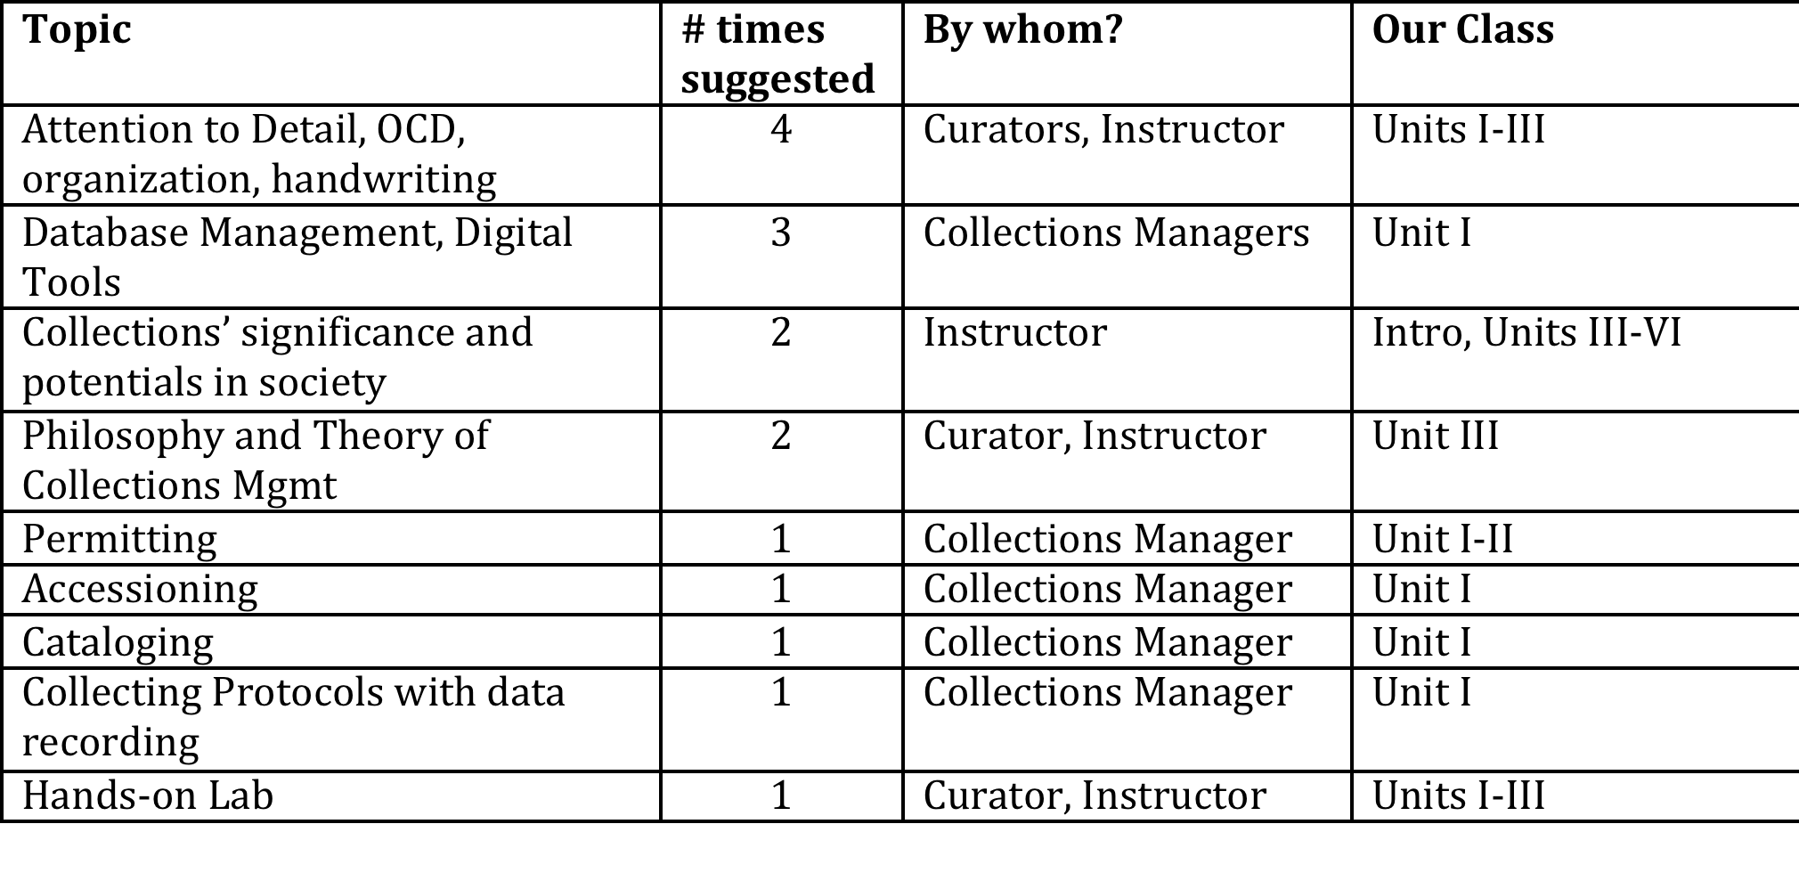
What Museum Scientists Want You to Know/Do
Museums Responding: Perot Museum of Nature and Science, Zoologische Staatssammlung München, Protect Heritage Corp, Virginia Museum of Natural History, Earth and Mineral Science Museum & Art Gallery, Penn State University, Ohio Historical Society, University of Kansas Biodiversity Institute, Museum of Archaeology & Ethnology, Simon Fraser University, Texas Tech U, J.F. Bell Museum of Natural History, University of Alaska Museum
Notes:
Natural History Collections List Serve 2014 question to curators, collections managers etc. throughout the world
They also recommended readings, activities and more. Plan to make course materials available on line for other places to use at GitHub

Slide 3
Learning Goals
Content
importance of collections and museums, including research, education and broader societal role/impacts
how to care for collections
how to add to, improve and assess collections
how and when to use collections
Importance of a mission statement
modern techniques used to address interesting questions in biology using museum specimens
Methods for effective science communication

Slide 4
Learning Goals
Skills
Practically apply taxonomy
Critically Read primary scientific literature
Present scientific content to a general audience
Write a convincing well-supported research grant proposal
Team and interpersonal skills
Print legibly
Organization
Observation and attention to detail
Applying knowledge in new settings
How to write for a scientific audience

Slide 5
Learning Goals
Products
Specimen Condition Report
Geo-referenced collection
Digital collections research project
Collection Survey
Science video for the public
Research Grant application
Notes:
This is for your career portfolio. When you apply for a position in a museum, at a graduate school or a nature center, you have something to show a potential employer to help you stand out of the crowd of applicants

Slide 6
Team Based Learning*
Small groups of students interact as in-class teams to apply content to simple and complex problems guided by feedback of the professor
Pre-class
Individual learns assigned content (3 hrs per week per credit hour = 9 hours per week outside of class)
In-class
Student teams apply content to problem-solving discussions or activities
During class
Students receive frequent and immediate feedback
*Team Based Learning was developed in the 1970’s by Dr. Larry K. Michaelsen, a Professor of Management at the University of Oklahoma, who wanted to change the passive learning in his lectures into active learning by testing and assigning students to teams.

Slide 7
Team-Baased Learning Process
Phase 1
Preparation
(Pre-class)
Phase 2
Readiness Assurance
(In-class)
Phase 3
Application of Course Concepts
Small Group Assignments
Individual Study
Instructor Feedback
Team Test
Team Appeals
Individual Test
Individual Work
Small Group Discussion
Total Class Discussion
Impact on Learning
X
X
=

Slide 8
Team-Baased Learning Process
Phase 1
Preparation
(Pre-class)
Phase 2
Readiness Assurance
(In-class)
Phase 3
Application of Course Concepts
Small Group Assignments
Individual Study
Instructor Feedback
- Video Reading Guide
Read articles or other written material
-Watch recorded lectures
Read other material outside of class, apply growing knowledge to produce an answer, product or idea
Team Test
iRAT and tRAT assess your preparation to begin Team Assignments
Team Appeals
Individual Test
Level of Content Understanding
40% 50% 60% 70% 80% 90-100%

Slide 9
Phase 2: Readiness Assurance Test Procedures
Individual Test
Team Test
Appeals
Questions & Discussions
Closed Book 3pt/question
Closed Book 3pt/question
Open book/notes
Clarify issues
Answer on individual answer sheet IN PEN
Team uses IF AT score card to answer questions
Show evidence from reading
Answer sheet goes in Team folder
Correct answers are revealed while test is underway (by scratch-off)

Slide 10
Phase 3: Application-Focused Assignment
Teams apply the fundamental concepts of the unit to a problem to produce an answer, product, or idea
Examples
Catalog or georeference museum specimens
Create a condition report for a specimen
Assess the status of a collection
Identify the critical information portrayed in a figure
Select the best method to test a new question

Slide 11
An Alternative to Lecturing
Lecture
Faculty identifies content in the syllabus and in lectures
Pre- class: Student “might” study concepts
In class: Student passively takes notes
Student accountability: homework, class participation?, final exam
Team Based Learning
Faculty identifies content for pre-class assignments, the syllabus and group interaction
Pre- class: Student “must” study concepts for test
In class: Student is tested on concepts and actively joins Team to solve increasingly complex concept applications
Student accountability: Student pre-class work and tests, Team tests and work, and final exam

Slide 12
What is the TBL Difference*?
 | Lecture | Team-Based Learning
Key points | Instructor provides content for student note-taking in a hall | Instructor-directed content applied to real world problems by student teams
Teaching Methods | Lecturer didactically provides content | Students prepare content before class. In class, they apply it in teams to solve problems
Outcomes | Content acquisition and conceptual understanding | Content acquisition, conceptual understanding, content application to solve problems, critical reasoning, effective communication, collaborative team work
Instructor’s role | Identifies learning objectives, prepares presentations and answers student questions | Identifies learning objectives and content, prepares readiness tests, answers student questions and prepares application assignments for team work
Student’s role | Attend lecture, study notes, prepare for exam | Do independent out-of-class study, join team discussions/work, defend team solutions to class
*Table excerpted from Baylor College of Medicine, Team Learning in Medical Education, September 2002

Slide 13
Difference Between a Team and Group
Group
2 or more people who interact on a common activity
Individual commitment to group is casual, temporary or permanent→accountability usually low
Groupwork may occur inside or outside of class
Team
2 or more people who interact on a common activity
Individual commitment to the welfare of the group
High level of trust among members of team
98% of teams will out perform the best member on learning-related tasks*
Teamwork should not be required outside of class
*From Michaelsen, L., Watson, W. and Black, R. (1989). A realistic test of individual versus group consensus decision making. Journal of Applied Psychology, 74(5), 834-839.

Slide 14
How are teams created?
By me
Using information from you:
Previous exposure to science
6-hats learning styles
Course enrollment is capped because of the limited space in the collections!

Slide 15
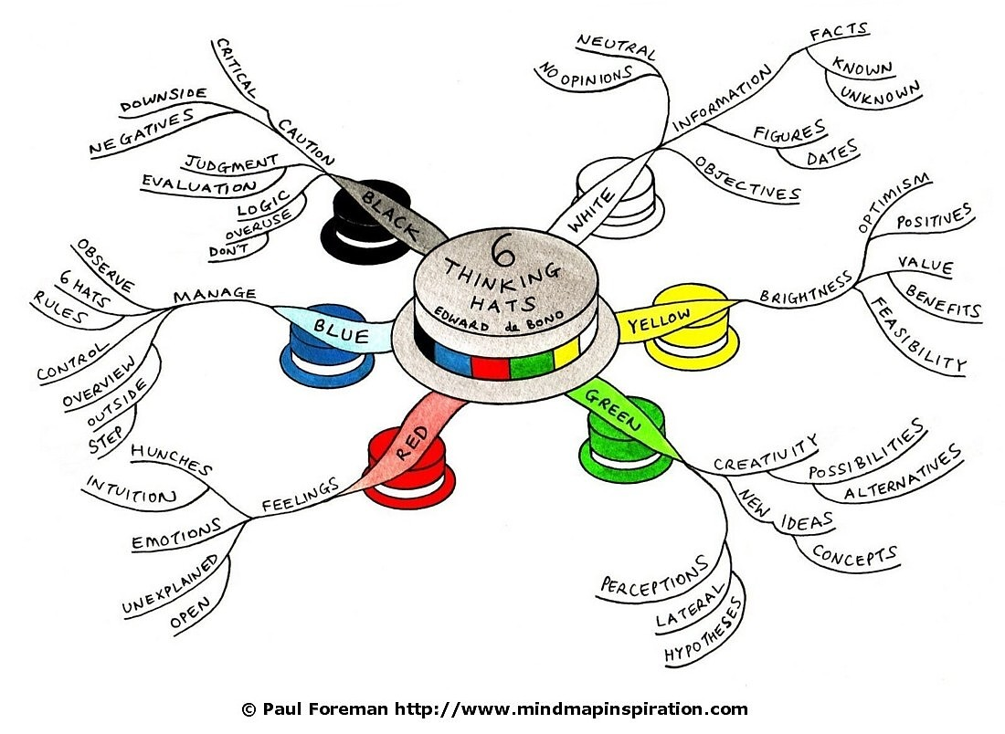
Notes:
Like a Myers Briggs test to identify personality traits, this identifies ways you might naturally interact in a group
The 6-Hats work of DeBono describes six ways of thinking/interacting in a group. DeBono’s primary
thrust in his work was to provide ways to enhance communication by identification of these
different communication styles or roles with the idea that, once a style/role is identified, it
becomes easier to switch into that style/role when needed

Slide 16
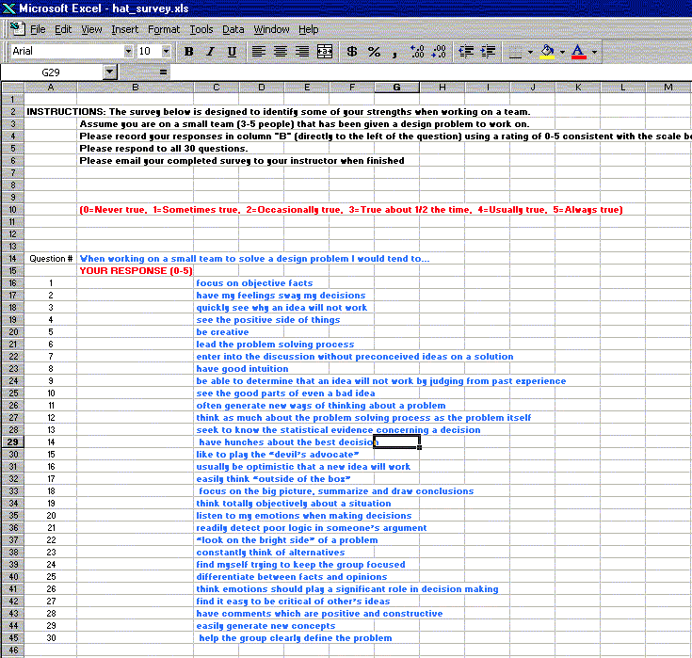
Due by 9 am tomorrow (Thurs.) On Moodle

Slide 17
